Slide 1
ERC Net Control Training
Idaho Falls Bishops’ Storehouse
10 March 2015

Slide 2
“All ERC operators should develop net control skills, and be able to use them under adverse conditions.”
ERC Handbook, p. 55

Slide 3
Outline
ERC Nets
Organization
NCS Responsibilities
Anatomy of a net
Loma Prieta
Table top exercise
Tour Radio Room

Slide 4
ERC Nets - Organization
Kevin Hemsley
Bob Hodgen
Regional Coordinator
NCS
NCS
??
Storehouse Net Manager
NCS
NCS
Notes:
Brother Hemsley reports to the Storehouse Agent Stake President.

Slide 5
ERC Nets - Organization
Team Supervisor
Net Control
Logger
Data Analyst
Backup NCS
Notes:
Mention also that this team reports to a priesthood leader, probably through a Stake ECS or Regional Coordinator.

Slide 6
ERC Nets - Purpose
“The ERC program was established to provide a means of emergency communication for priesthood leaders when all other means of normal communication become inoperable. The ERC Net fulfills that purpose.”
ERC Handbook, p. 54

Slide 7
Anatomy of a Net

Slide 8
What net is this?
This is AK7ME calling the Rigby Region Emergency Response Communications Net which meets at 8:30 p.m. local time each Wednesday on 147.540 MHz SIMPLEX.
Defines the Net Control Station (NCS)
Net frequency
Date, time and name of the net
Notes:
Backup NCS?
Alternate frequency?

Slide 9
Why am I on this net?
The purpose of this regional storehouse net is to exercise communications between assigned stakes and the Idaho Falls Bishops' storehouse, train radio operators, test their equipment, improve operating skills, pass message traffic and prepare for emergency operation.
Oh right, this is practice !

Slide 10
What am I supposed to do?
Net members are encouraged to check in to the net on emergency power (separated from the grid) whenever possible in order to "test" emergency power sources. This net is directed by net control station AK7ME.
Please do not transmit unless directed to do so by Net Control. Relay information for stations not heard by Net Control will be accepted from other operators at any time. If you have relay information, so indicate by using the word "relay" and your callsign.

Slide 11
How do I handle traffic?
This net will respond to emergency traffic at anytime. If you have emergency traffic, use the word "emergency" to break the net proceedings.
Routine traffic should be listed during the roll call when your stake is called. If there is any "Priority" traffic, it should be listed now
Define how traffic will be handled – especially emergency traffic

Slide 12
Operators are asked to checkin
Call for each stake or organization
Additional clarifications or instructions
Frequent pauses for priority or emergency traffic
Bottom line – orderly, directed and efficient!
Notes:
It is a good idea to reiterate the name of the net periodically. You can do this when you identify yourself every 10 minutes:
“This is AK7ME, net control for the Rigby Region ERC net.”
When on a repeater, the repeater will identify itself every 10 minutes, a good reminder for you to do so, also.

Slide 13
Last Call
Are there any late or missed ERC stations wishing to check in to the ERC Net?
Is there any additional traffic or system business for the ERC Net?
Are there any visitors wishing to check into the ERC Net?
Late, missed, visitors or additional traffic – last call!

Slide 14
Closing
The Rigby Region ERC Net is now closed. We now encourage all stations to change frequency to the 146.880 MHz repeater (with a 100 Hz Tone) to check in to the Idaho Falls Bishops' Storehouse ERC Net which starts at 9:00 p.m. each Wednesday evening.
All stations are released. Thank you for your participation. The frequency is now clear for normal communications
Release the frequency and release the stations

Slide 15
Web Site Demonstration

Slide 16
NCS Responsibilities
On a net, NCS determines…
Who
What
When
Where
How

Slide 17
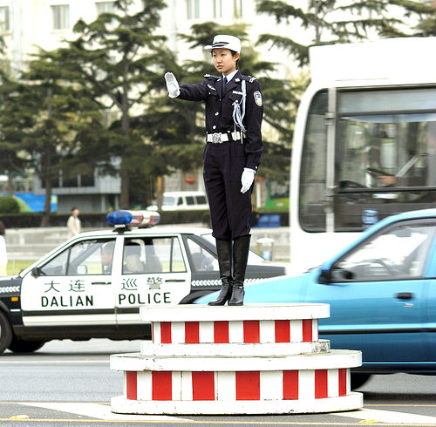
Notes:
NCS compared to a traffic cop:
Responsible for one intersection
Commanding, visible position

Slide 18
Location, Location, Location!
Where she can be heard
Responsible for one net
Take ownership
Notes:
NCS:
Responsible for one net
Commanding signal
On an HF net, I heard NCS say, “Net Control acknowledges VE3RTM”.
Use first person: “Roger, VE3RTM”
You are in charge; everyone knows it. Act like it.
Can you image the traffic cop glancing to the sidewalk to get approval from the sergeant before waving through any vehicles? Where will the vehicles begin to look?

Slide 19
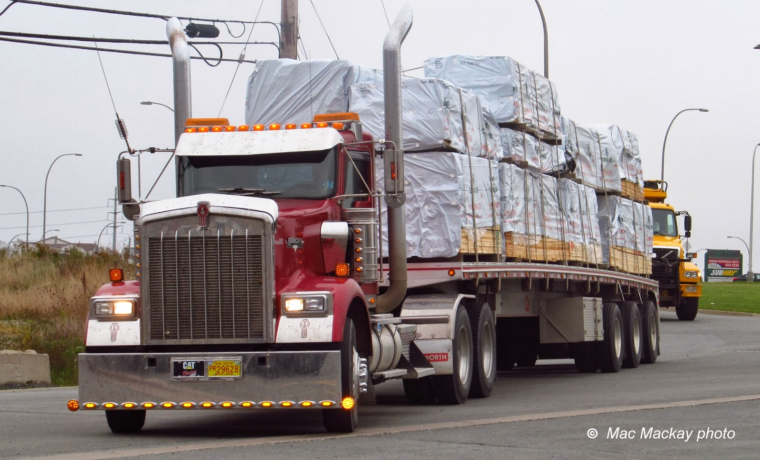
Notes:
Traffic cop responsible for prioritizing and routing different types of traffic
Truck loads of lumber

Slide 20
Notes:
Traffic cop responsible for prioritizing and routing different types of traffic
Families headed for Disneyland

Slide 21
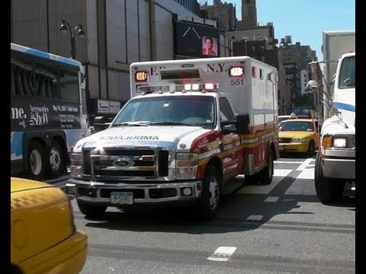
Notes:
Traffic cop responsible for prioritizing and routing different types of traffic
Emergency vehicles with lights flashing and sirens blaring.

Slide 22
Prioritize Traffic
Emergency
Priority
Welfare
Routine
Loma Prieta Traffic Prioritization
Notes:
NCS responsible for prioritizing and routing all different types of traffic (messages and information)
Emergency calls take precedence over all else
Emergency = There is an immediate hazard that will result in serious injury or loss of life.
Priority = A hazardous condition exists or is developing that COULD result in serious injury or death to persons or property.
Audio:
Three stations call in; NCS tells them which order to give their reports
NCS asks one station to standby and takes a report from another.
Two stations call in, the second with emergency traffic. NCS takes the emergency traffic first.

Slide 23
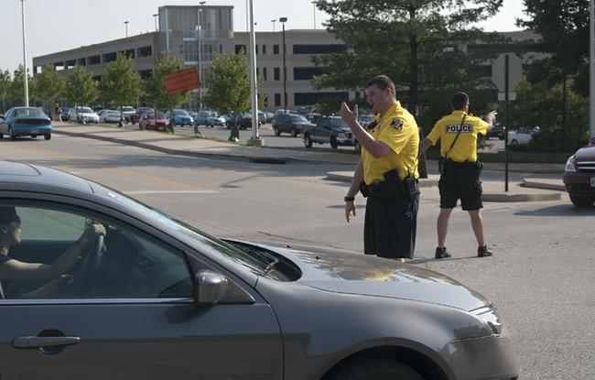
Notes:
Traffic situation require one or two officers to direct traffic…

Slide 24
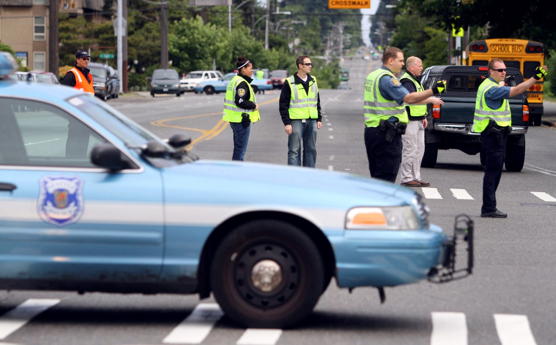
Notes:
…to several assistants depending on the situation

Slide 25
You are not alone
Backup NCS
Loggers
Liaisons
Runners
Critical Frequency Monitors
Phone or FAX Operators
Computer Operators
Digital Mode Operators
Notes:
NCS also has the option of commissioning any number of assistants to help with a net and traffic handling.
Traffic Loggers: Incoming and outgoing
*Liaisons
Several liaisons may be necessary, depending on how many served organizations there are.
There might be a regional net with several stake nets running. A liaison might exist for each stake.
There might be a liaison at the EOC, at BYU-Idaho, at the Red Cross, or any number of other served agencies.
Runners
…between rooms or buildings or sites.
Runners may be responsible for deploying radios or replacing dead ones with working ones.
NCS needs to have a scribe, preferably on-site.
Operators may also need to have a scribe, depending on their role.

Slide 26
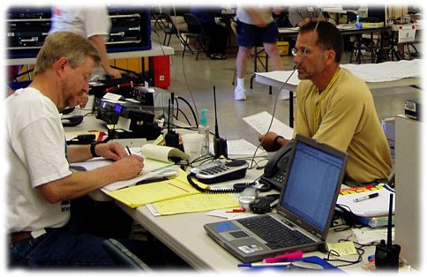
ERC Net Control Team
Most Crucial Roles
Net Control Station
Backup Net Control Station
Traffic Logger
Information Analyst
Team Supervisor

Slide 27
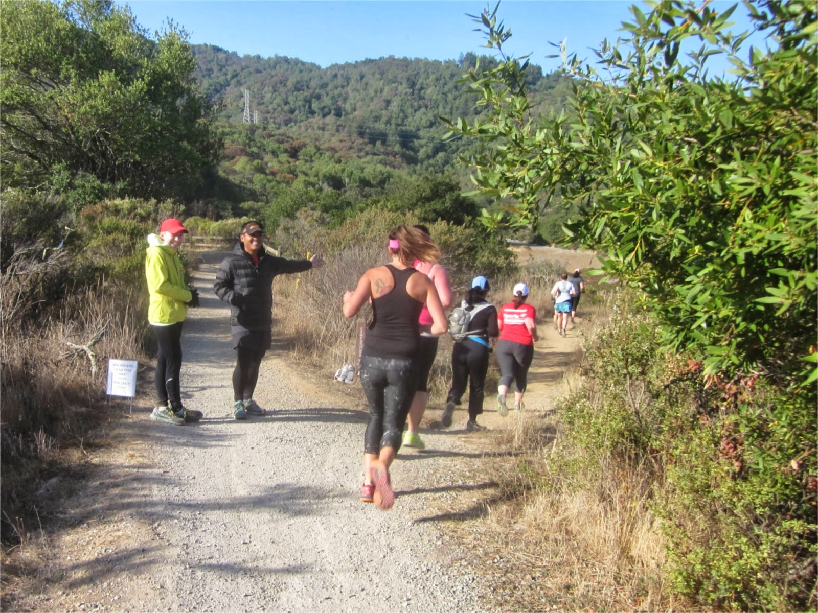
Notes:
Traffic cops may be responsible for simply directing all traffic down a pre-determined path.

Slide 28
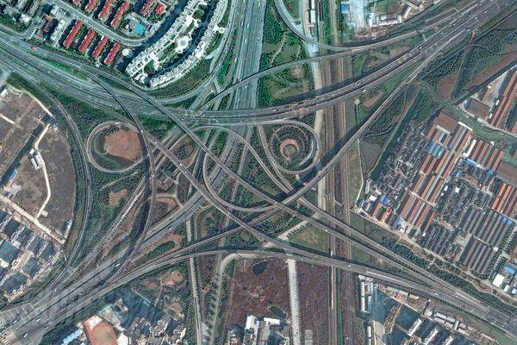
Notes:
Conversely, traffic patterns can be complex and confusing.

Slide 29
Notes:
So officers should remain flexible and agile.

Slide 30
Be Flexible
Adapt to the needs of the situation.
Request Assistance.
NCS Asking for Assistance
Notes:
NCS also can experience a wide variation of traffic situations on a net.
A net can be a casual, Wednesday evening check-in.
Or a fast paced, lots-of-traffic, complex emergency net.
Net Control Operators need to remain flexible and agile, adaptable to the needs of the situation.
Audio Example:
NCS seeks someone to make a phone call
NCS asks someone to check for traffic on another repeater

Slide 31
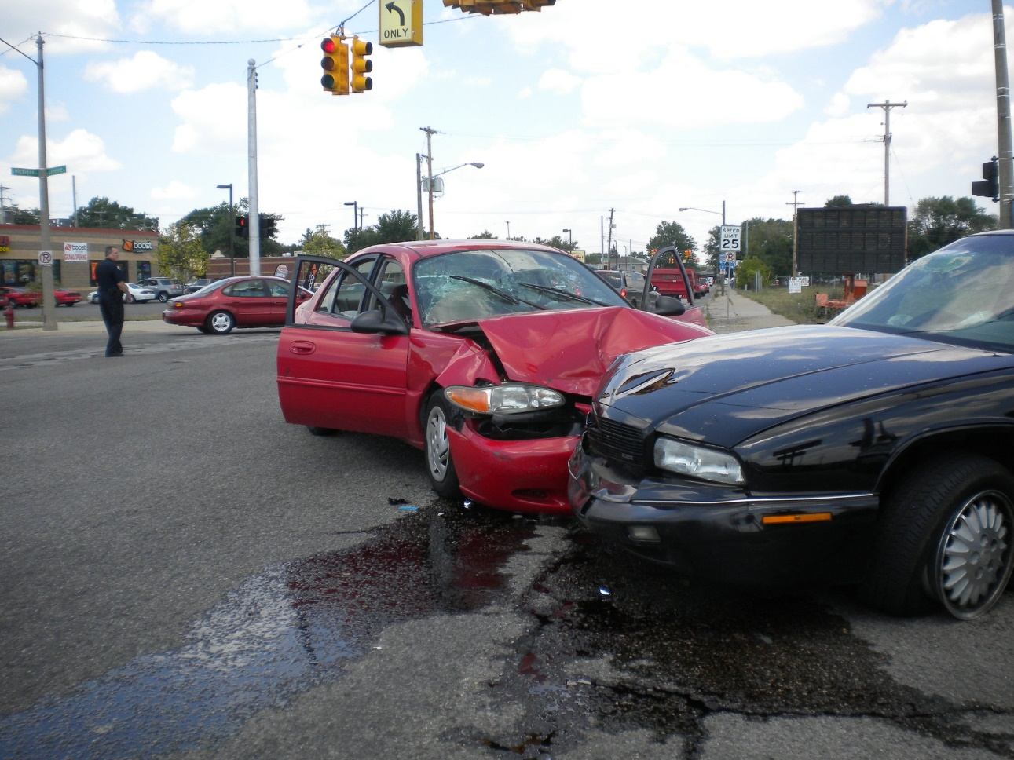
Notes:
Things don’t always go as planned.
Even the best trained officers make mistakes and accidents happen.

Slide 32
Oops
Learn from your mistakes
Listen to other nets
What-If
Practice, Practice, Practice
If you don’t know what to do with a piece of traffic, log it, move on, and come back to it when you can.
Notes:
Take notes
Conduct personal mini lessons-learned sessions after each net.
Record what went well and what did not.
Write down what you would do different.
Review your notes before each net

Slide 33
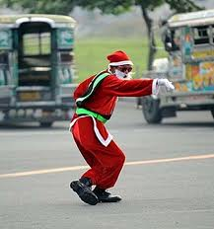
Notes:
Traffic Cops can exercise some humor and still efficiently direct the traffic through their intersection.

Slide 34
Humor
Keep it light hearted and humorous, if you can.
Reduces tension and stress.
Use it appropriately.
Notes:
Keep the net light hearted and humorous, if you can.
Humor can reduce tension and stress.
Remember that there is a time and place for humor. Use it appropriately.

Slide 35
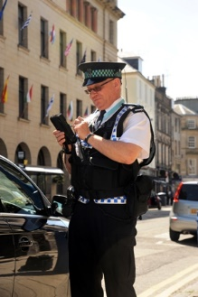
Notes:
Drivers don’t always do what they’re supposed to do.
Warnings and even Citations must sometimes be issued to help keep order.

Slide 36
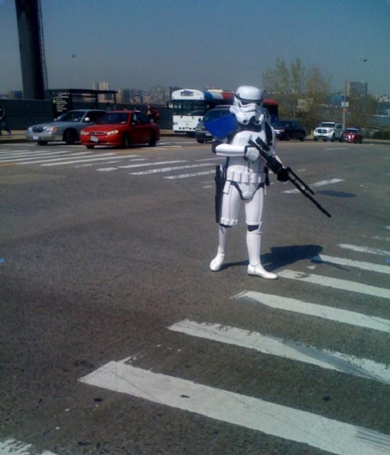
Notes:
I think we would all prefer that the officer issuing the ticket is cordial.
This picture adequately depicts the type of traffic cop we would all like to avoid!

Slide 37
Discipline
Maintain Net Discipline
Be Kind and Courteous
Choose your battles
Notes:
NCS must maintain net discipline, but it is possible to do without being a Storm Trooper.
As NCS, you set the level of net discipline
If an operator is upset about something, be kind, courteous, and helpful.
It is not necessary to agree with an offender, but it is okay to acknowledge that there is a problem or issue.
Perhaps there is another operator that can deal with issue on a different frequency, or better yet, off the air.
You might consider asking the operator to come to net control and log or act as a runner
Adopt phrases like “KB7ITU, I appreciate the information… the purpose of this net is … OK?” and teach them (and everyone else).
If necessary, ask them to standby and come back to them when you get a chance.
Irrate Operators
. Do not respond in kind
. Ask them to call you (or a helper) on a land line
. Acknowledge the problem; you don’t have to agree
. Ask for reasonable solutions
. You may have to relieve them of the assignment
We are striving to be perfect, but none of us are there yet.
Don’t put undo pressure on yourself or others to get there prematurely.

Slide 38
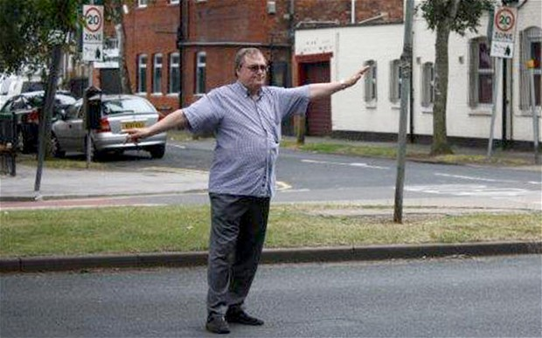
Notes:
Sometimes, in the absence of an officer, pedestrians can step in and help reduce the chaos until a sworn official arrives.

Slide 39
Ad Hoc
Be Ready2Go!
Paper & Pencil
Hardcopy of Roster
Adhoc Example
Notes:
If NCS is not on frequency, does that mean that the net does not happen?
As a bystander, you have the net until an assigned NCS arrives. However, commanding signals should win out.
When given the choice between an experienced NCS with a week signal and an inexperienced NCS with a strong signal, choose the stronger signal.
Audio Example:
Ted is operating as net control of a directed net. Some un-directed traffic comes through and someone, not NCS, calls for net discipline.
Ted thinks they’re talking about him, too, and stops transmitting until another operator reminds him that he, Ted, is NCS, where he picks up right where he left off.

Slide 40
NCS Qualities & Responsibilities
must have a commanding signal
is in charge of the net
activates and assigns resources
must keep track of resources
assigns tactical calls
keeps a good log
has a clear speaking voice
controls his or her tone of voice
has good command of the English language
can handle physical and mental stress for long periods
can listen and respond in a noisy/chaotic environment
has good hearing
writes legibly
enforces net discipline
uses tactical calls
uses standard phonetics
uses plain English - no "10" codes or "Q" signals

Slide 41
NCS Qualities & Responsibilities
thinks before keying
is as concise as possible
knows how to operate the radio
frequently identifies name and reason for the net
transmits only facts, not conjecture
takes frequent breaks
when transmitting, key up, take a breath, then talk

Slide 42
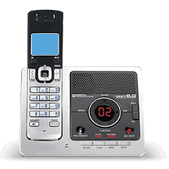
Preparing for a Net
Be Ready(2Go)
Mitigate Interruptions
Delegate the phone
Turn down other radios
Rig is ready
Accuracy trumps speed
Have a contingency plan
Begin on time
Notes:
Ready = preambles, logs, forms, pens/pencils, rosters, and other aids out and at hand.
Marty will cover some of these in more detail.
Ask a family member to answer the phone or door; turn the ringer off if necessary.
Turn down the volume on other radios or scanners and electronics
Rig:
. Are you on the right frequency?
. Is the tone and offset properly set?
. Are you connected to the correct antenna?
. Is everything in working order?
Accuracy vs. Speed
. It is more important to get the message across accurately than it is to get it quickly.
. If you find yourself making mistakes or operators are asking for fills, slow down.
Contingency
. Do you have a backup NCS assigned?
. If you’re logging on a computer, what if it crashes?
. Do you have another radio you can switch to?

Slide 43
Answering a Call
Avoid “this is” or “go ahead”
Net Control is calling the Hart Shelter:
“Hart Shelter, Net Control”
The Hart Shelter answers with:
“Hart Shelter”, not “This is Hart Shelter, go ahead Net Control”
Net Control will answer with the other station’s identifier
Hart Shelter calling Net Control: “Net Control, Hart Shelter”
Net Control responding: “Hart Shelter”
Notes:
“This is Hart Shelter, go ahead Net Control” = 2.5 seconds to say
“Hart Shelter” = .75 seconds
Over the course of 30 exchanges, this simple adjustment saves almost 1 minute of time.
There is only one net control. If there is a double—two stakes calling net control simultaneously—and net control responds with “Net Control”, to whom is net control responding? In order to eliminate confusion, net control responds with the calling station’s identifier.

Slide 44
Acknowledging
To answer “yes”, use “affirmative”
To answer “no”, use “negative”
To acknowledge receipt of a transmission,
use “roger”
“Henry’s Fork Stake, Net Control”
“Henry’s Fork Stake”
“Have you received additional supplies from Hart Shelter?”
“Negative”
“Contact Hart Shelter on 147.570 MHz for additional supplies.”
“Roger, Henry’s Fork Stake, KB7ITU”
Notes:
As written above, about 20 seconds.
The exchange can easily take twice as long, or longer, if this format is not followed.

Slide 45
Relaying
Break the net by saying, “Relay, N7TMS”
Once acknowledged, the relay station becomes net control for the station being relayed.
“Relay, N7TMS”
“Relay” (‘Relay’ becomes a tactical call sign)
“N7TMS, Relay for Net Control. N7RGW, come now with your report.”
[N7RGW transmits his report]
“Net Control, Relay”
“N7RGW reports ….” (N7TMS gives N7RGW’s report exactly.)
“… Back to net control. N7TMS”

Slide 46
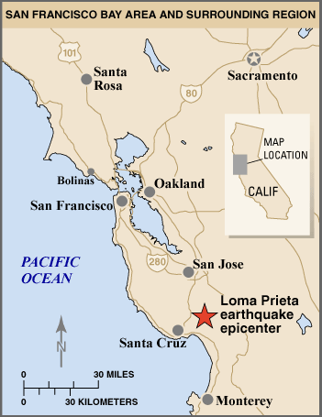
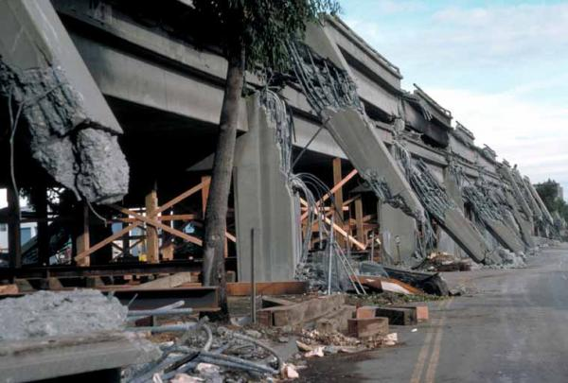
Loma Prieta Earthquake
October 17, 1989
7.1 Earthquake
Video of the Quake
Situation Awareness Net
Notes:
Watch YouTube video, 1:45 – 5:00

Slide 47
Scenarios
Notes:
What do you think is happening?
What would you do and/or what would you say?

Slide 48
Scenario 1
You are NCS for a net. You are taking check-ins and you can only hear “ . . .(static) MR.”
Weak Station
Ask operator to use phonetics
Ask for relays for the “MR” station

Slide 49
Scenario 2
You are participating in a weekly ERC simplex net. The NCS stops transmitting in the middle of a sentence. Nothing is heard for 30 seconds.
NCS’s rig has failed in someway
Ask if there is a backup NCS on frequency
You assume the net

Slide 50
Scenario 3
You are NCS for a net taking check-ins and you hear
“ . . . static . . . repeater keying . . . static”.
Possible low battery or weak station
Advise the station to use an alternate power source
Ask other stations to listen on the input
Ask for relays

Slide 51
Scenario 4
While acting as NCS, you hear someone whistling “Yankee Doodle” each time you unkey.
Intentional Interference
Ignore the offender
Change to an alternate frequency

Slide 52
Scenario 5
While listening for stations to check in, you hear one voice saying “This is . . . ” and another voice immediately following saying “November 7 Uniform Tango”.
Double
Take the N7UT report. Then ask for additional check ins.
Notes:
Do not spend time trying to decipher the doubles. Handle the operators you hear and then call for more check ins.

Slide 53
Scenario 6
During a situation awareness net, you have requested check-ins with traffic and traffic only. A station says “I want to have a short informal with K5CTR if he checks in. Oh, by the way, I am N7TMS.”
This traffic is outside the bounds of the net.
Net discipline
Invite N7TMS to contact K5CTR after the net.

Slide 54
Scenario 7
You are about to read the closing statements on an ERC net and a station says, “I think this is a lousy time to have this net. I am trying to have dinner now. Why can’t you change the time? My wife is complaining. N7TMS.”
Net Discipline
Acknowledge the concern. “I understand this can be a difficult time for some operators.”
Ask if NCS can contact N7TMS after the net via landline.

Slide 55
Scenario 8
You've asked stations to give their call signs phonetically. Then you hear, “I am Kan't Find Two Things To Eat.”
Misuse of phonetics
Encourage operators to use standard phonetics

Slide 56
Scenario 9
You are reading the preamble for your net. After the second paragraph when you unkey you do not hear the repeater. You hit the mic button again and nothing is heard.
Rig or Repeater Failure
Ask for a radio check from operators listening on the input
Contact backup NCS on the alternate frequency

Slide 57
Scenario 10
While serving as NCS, you call for check-ins from the North Stake, but hear no responses.
No one in the North Stake on frequency or rig failure
Call for relays
Move to the next stake and catch late North Stake operators when “late or missed” are called for.
Allow the backup NCS to take the net.

Slide 58
Scenario 11
After all the traffic is passed and you have asked for announcements, a station says, “I want to let everyone know I am doing odd jobs on the side. Can I give out my phone number now?”
Net Discipline
Inform the operator that amateur radio is not the place for advertising this type of service.
Notes:
It is okay for an operator to offer occasional help, but this message seems to be an on-going, blanket, “I’m looking for additional work” type of advertisement.

Slide 59
Scenario 12
You have requested stations in the south area of the region to check-in to the shelter at the South Stake Center. A station responds with “This is WD7RR, QNN, and I QSL and QRU.”
Net Discipline
Inform the net that Q-signals and 10 codes should not be used on voice nets.

Slide 60
Scenario 13
You are NCS for a directed net and have asked for questions or announcements. A station says, ”I have a question for Bob K7RES. Bob, are you on frequency? I want to know if you are going to the meeting Friday?”
Net Discipline
Stations should wait to be acknowledged before transmitting their traffic.

Slide 61
Scenario 14
A station checks into your Storehouse net with very loud music playing in the background.
Net Discipline
Remind the net that the transmission of music over amateur radio frequencies is not permitted.

Slide 62
Scenario 15
A station reports “Net Control, your signal is breaking up and you are not making the repeater consistently. Should we go to simplex?”
Weak NCS Signal
Backup NCS should take the net
Moving to simplex may not help the situation
Notes:
If NCS has a weak signal into the repeater, it will only be exacerbated by simplex operation.

Slide 63
Scenario 16
You are running a regional net and a station checks in saying “I just got my call sign and I don’t know what to do with it.”
Net Discipline
Ask for the station’s call sign and invite her to contact you after the net via land line.
Refer the station to their Stake ECS

