Slide 1
Stake Emergency Communication Specialist
Idaho Falls Bishops’ Storehouse
2016-04-17

Slide 2
The Role of the Church
Before an Emergency
Encourage and assist membership to prepare
Plan and practice
During an Emergency
Assist civil authorities as requested
Provide situational information and updates
Provide access to physical facilities
After an Emergency
Repair, rebuild, recover, and report
Notes:
Emergency communications is a part of a greater whole
Important to understand the Church’s role to place the ECS role into its proper context

Slide 3
Role of a Stake ECS
Before an Emergency
Assist in planning
Train ECS’s
During an Emergency
Organize and facilitate communication
After an Emergency
Assist with Repair, rebuild, recover, and report
Lessons Learned
Notes:
Teach preach expound exhort and visit the house of the members

Slide 4
Called and Set Apart
A Stake ECS is called and set apart by the stake president.
You will need the blessings that go along with being set apart. If you haven’t been set apart, you should ask for this blessing.
Notes:
Bishops call and set apart ward specialists.
Stake ECS may be asked to recommend individuals to be called as ward ECSs

Slide 5
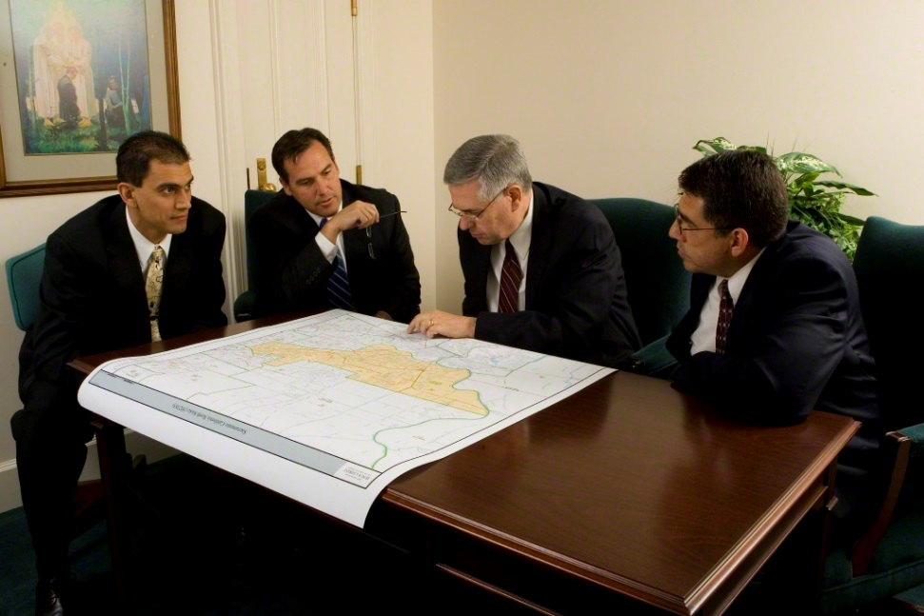
ECS Works with Stake Leadership
The Stake ECS assists the stake in developing and maintaining the ability to communicate in an emergency
ECS works with high counselor over emergency preparedness or whomever Stake President assigns
Notes:
It is key that all emergency communication specialists work under the guidance and direction of their priesthood leadership.
Generally, a High Counselor will have responsibility for “Preparedness”. In those cases, look to that person for direction and guidance.
The ECS is an advisor to assist leadership in making decisions regarding emergency preparedness including communications.
The ECS implements whatever decisions are made by priesthood leadership
It is not the job of the emergency communications specialist to sell ham radio or anything else to the stake president. The ECS may make recommendations, but the stake president is the guy in charge.

Slide 6
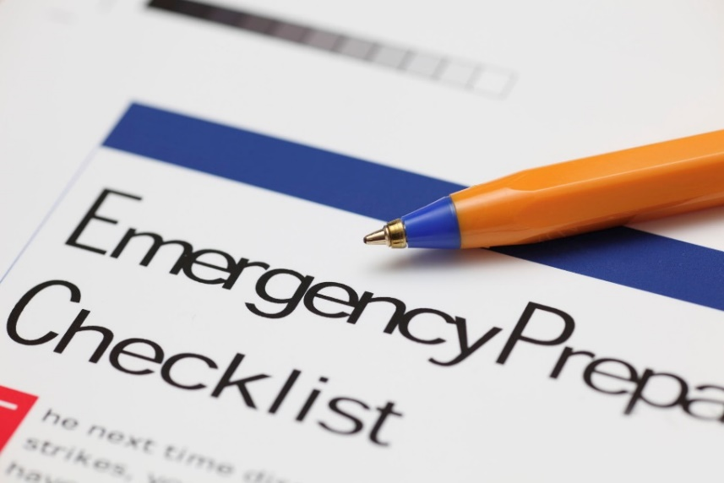
Emergency Communications Plan
As directed by the Stake President, the Stake ECS assists in the preparation of the stake emergency communications plan
The communications plan is included as a part of the comprehensive stake emergency plan
Notes:
ECS need to work with their stake leadership on the development of a stake emergency communications plan.
IMPORTANT NOTE: The stake emergency communications plan should be part of the much more comprehensive Stake Emergency Plan. The ECS should make recommendations on what to include in the emergency communications plan section.
The ECS will need to work with his team (such as ward ECS and high councilman over emergency preparedness) to develop a plan to communicate.

Slide 7
Assists Wards and Branches
As directed by the stake president, the Stake ECS assists units within the Stake to prepare emergency communication plans
The Stake ECS should be a resource to the units in the stake
The ECS is an advisor and a resource, but does not direct
Notes:
Remember that the ECS always works under the direction of priesthood leadership. We should make recommendations, but we do what we are asked to do.
The ECS should confer with priesthood leadership and do as they direct.
The ECS is a resource and advisor. The stake president is the guy in charge.
It may feel like we are doing the work. We will be asked to DO much. Avoid entitlement.

Slide 8
Communicates with Bishops’ Storehouse
The stake ECS is responsible for maintaining the ability to communicate with the bishops’ storehouse for weekly exercises, and during an emergency
Notes:
The weekly storehouse radio nets are an important element of maintaining readiness.
Stakes have been asked to check in with their respective storehouses on a periodic basis. If the ECS can’t personally check in, he should ensure that someone else representing the stake checks in to the radio nets.

Slide 9
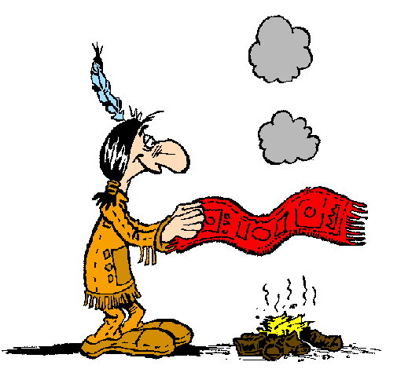
Organizes In-Stake Communications
The stake ECS is responsible to organize and test the ability for a stake to communicate in an emergency
Stake President chooses the method of communication
Notes:
The stake president chooses the best method of emergency communications for the stake. The ECS is an advisor.
The ERC program is NOT a ham radio program, it is an emergency communication program. We have many communication tools available to us.
Some stakes use FRS, some use GMRS, some are using MURS, others have asked stake members to get Amateur radio licenses and they use Amateur radio. Many localities use a combination of methods.
The Idaho Falls Bishops’ storehouse has standardized on Amateur radio for stake to storehouse communications. So each stake needs to be able to communicate with the storehouse using 2M Amateur radio.
In-stake communications can use anything including smoke signals, but the stake president ultimately makes the decision on what is used.

Slide 10
Maintains Emergency Contact Information
The stake ECS is responsible for maintaining a list of needed telephone numbers and emergency contact information
One recommended tool is the use of emergency contact sheets
Review regularly
Notes:
One of the key lessons by ERC operators from exercises and emergency events is that ERC operators did not have emergency contact information for priesthood leaders, or other ERC operators, or the bishops’ storehouse.
This is one of the most important things that an ECS can do.
Emergency contact information needs to be reviews on a regular basis. Put it on your calendar and schedule regular reviews.
A great idea is to review everyone’s contact information each General Conference: Spring and Fall.

Slide 11
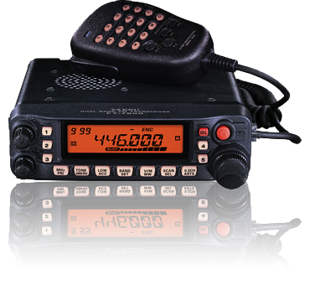
Uses personal radio equipment
Stake ECS uses personal radio equipment in their assignment
Wards and stakes should not accept donated radio equipment for use in an emergency or for installation in a meetinghouse
A mobile radio is recommended over a handheld
Notes:
ECS should use personal radio equipment.
Wards and stakes should not purchase or accept donated satellite telephone or amateur radio equipment for use in an emergency or for installation in a meetinghouse.
Leaders are encouraged to identify individuals who may already have their own equipment to assist with specific ward and stake communication needs.
When the choice is between a mobile and a hand held radio, a mobile radio may be the better choice. Chapter 12 of the ERC manual discusses this.

Slide 12
There is no such thing as a team of one!
Notes:
It is your job to work with your stake leadership to develop a plan and decide who will be on your team.
Imagine a communications team of one person: Quick, call the 1st Ward and see if they have any damage and need assistance. Wait a minute… there is nobody in the 1st ward to answer the call. Hold on self, I’ll have to go over to the 1st ward and check myself. Okay, now somebody else call the 3rd Ward and check on them. Wait a minute… There is nobody else to make the call, and nobody in the 3rd Ward to answer. It is sure tough being a team of one!

Slide 13
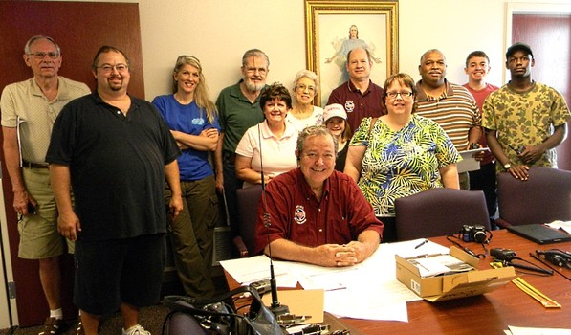
Identify All Radio Operators
Learn who they are, and how to contact them
Member and non-member
Notes:
Learn who all the radio operators are in your stake, and how to contact them. You should know both church members and nonmembers. As the stake ECS, you should be in regular contact with all of the operators in your stake. They need to know who you are, and you need to know who they are.
1.) Start by looking at the net roster for your storehouse or region to see which operators are on the ERC records. Check the IdahoERC.org website for this information.
2.) Work with your stake high councilor to ask the wards in the stake to pass around forms asking for licensed operators, and others who are interested in getting a license.
You should exchange emergency contact sheets with the ERC operators in your stake.
You should all know how to get in touch with each other.
They don’t have to be radio operators!

Slide 14
Meet Regularly with ERC Operators
Regular meetings are an often overlooked tool for stake ECSs
Regular stake ERC meetings are an opportunity to organize and maintain the effectiveness of the stake emergency communications plan
Notes:
After you have identified your stake operators, schedule regular meetings with them.
Review the stake emergency communications plan, and test the plan regularly. The stake ECS should train the operators of the stake.
Welcome both members and nonmembers who reside in the stake boundaries. By creating a team atmosphere, you will learn to work cohesively and everyone will benefit for the increased fellowship and learning opportunities.
Without regular meetings, a stake ECS can become a team of one, which we’ve already learned doesn’t work well. Regular meetings are an often overlooked tool for stake emergency communication specialists.
If you stake leadership had instructed wards to call ward ECSs, then the regular stake ERC meetings are an opportunity to organize and maintain the effectiveness of the stake emergency communications plan.

Slide 15
Attend Monthly Training Meetings
Idaho Falls Storehouse offers monthly ERC training meetings
If you take advantage of these training meetings, you will learn and grow
Great way for stakes to train the operators in their stake

Slide 16
Participate in Weekly Radio Nets
The Idaho Falls storehouse has radio nets each Wednesday evening
8:30 p.m. Regional Nets
Each operator checks in
9:00 p.m. Change to 146.880 MHz repeater
Storehouse training and exercises

Slide 17
ERC Website
http://idahoerc.org
Changes are coming.
Facebook: www.facebook.com/ERCidaho
Twitter: www.twitter.com/ERCidaho
Notes:
Login!
Do you have an account?
Great many tools!
Changes are coming. More tools are coming

Slide 18
In An Emergency…
The Stake ECS is the communication link between the stake and the bishops’ storehouse and civil authorities
The ECS needs to be prepared to quickly contact his stake leadership when he becomes aware of an emergency event
Notes:
The website is not available to those outside of the Church’s North America Idaho Area which includes Montana.
Your user ID is your call sign
If you haven’t logged in, get a password and log in
Access to a log of ERC information

Slide 19
In An Emergency…
The stake ECS needs to be able to keep the stake president informed and assist in providing communications within the stake and outside of the stake
The stake ECS needs to be very well acquainted with the stake emergency plan
The stake ECS needs to have a close relationship with the stake emergency preparedness specialist
Notes:
The website is not available to those outside of the Church’s North America Idaho Area which includes Montana.
Your user ID is your call sign
If you haven’t logged in, get a password and log in
Access to a log of ERC information

Slide 20
Key points to remember
Stake presidents hold the keys to emergency communication in the stake
The stake president is the person entitled to revelation on emergency communications for the stake
All emergency communication planning and operation is under the direction of the stake president
The emergency communication specialist acts as an advisor or counselor on emergency communication
It is not the responsibility of the emergency communication specialist to “sell” emergency communication or amateur radio to the stake president

Slide 21
Questions

